Slide 1
Code Search Engine
Marcus Stewart, Daniel Gilley, Arman Bahraini, Robert Wenger

Slide 2
Project Description and Requirements

Slide 3
Requirements
Web app
Allow to write textual queries
Search keywords from the query in a selected code repository from github
Visualize instances of the keywords, including:
File name
Author of the words
Revision date
Commit message

Slide 4
Requirements Cont.
Allow sorting of results, by:
File name
Author of the words
Revision date
Commit message
Allow exporting results to a downloadable file
Allow importing results from an uploadable file

Slide 5
Use Cases
Create query
Select a repository to search
Search a repository
Limit query to code changes or to commit messages
Filter results by time frame
Filter results by contributor
Visualization (expand result for more info)
Visualization (follow result to commit)

Slide 6
Use Cases Cont.
Refine existing query and update results
Sort results by file name
Sort results by author
Sort results by revision date
Sort results by commit message
Export results to file
Import results from file
Re-search query from imported file

Slide 7
Non-Functional Requirements
Web App
Return Results Quickly
Simple and Easy to Use
Visually Appealing

Slide 8
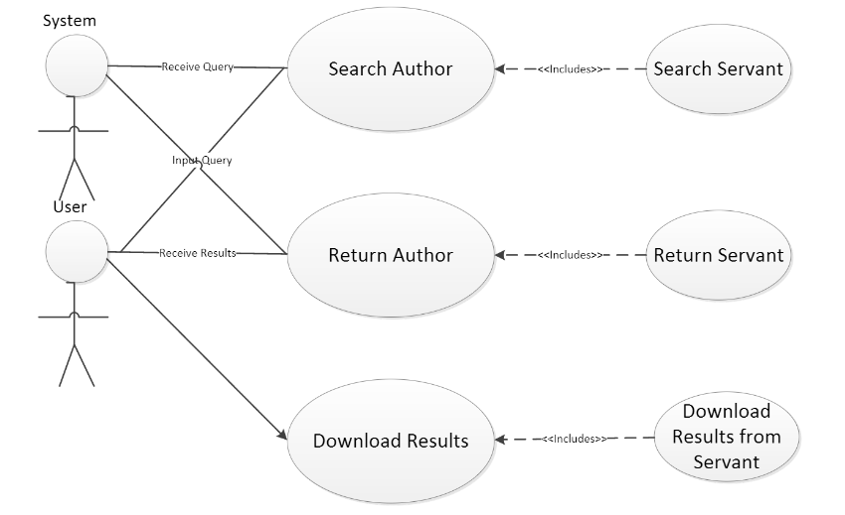
Use Case Diagram

Slide 9
High Level Design

Slide 10
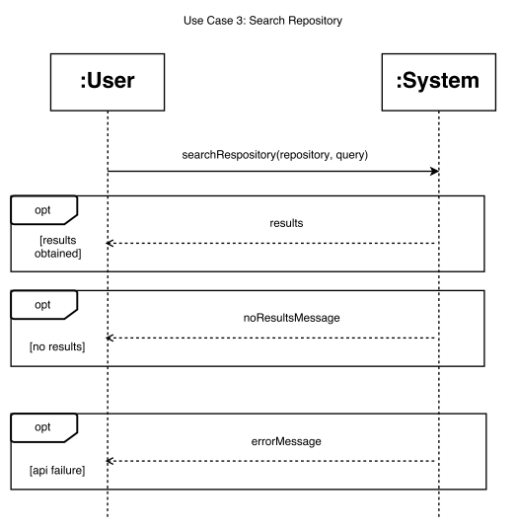
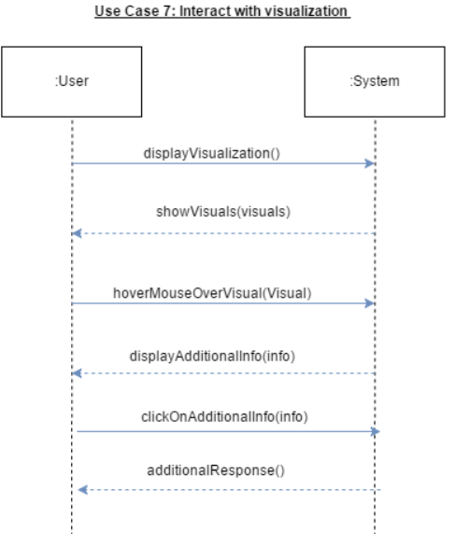

Slide 11
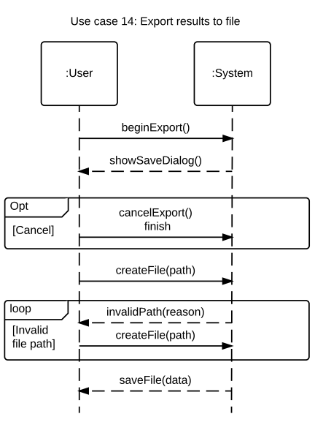
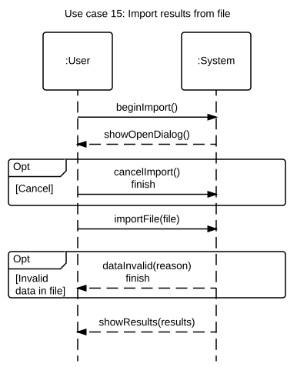

Slide 12
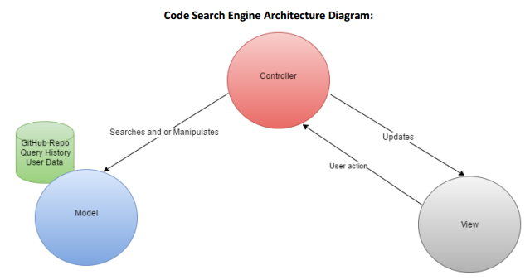

Slide 13
Detailed Design

Slide 14
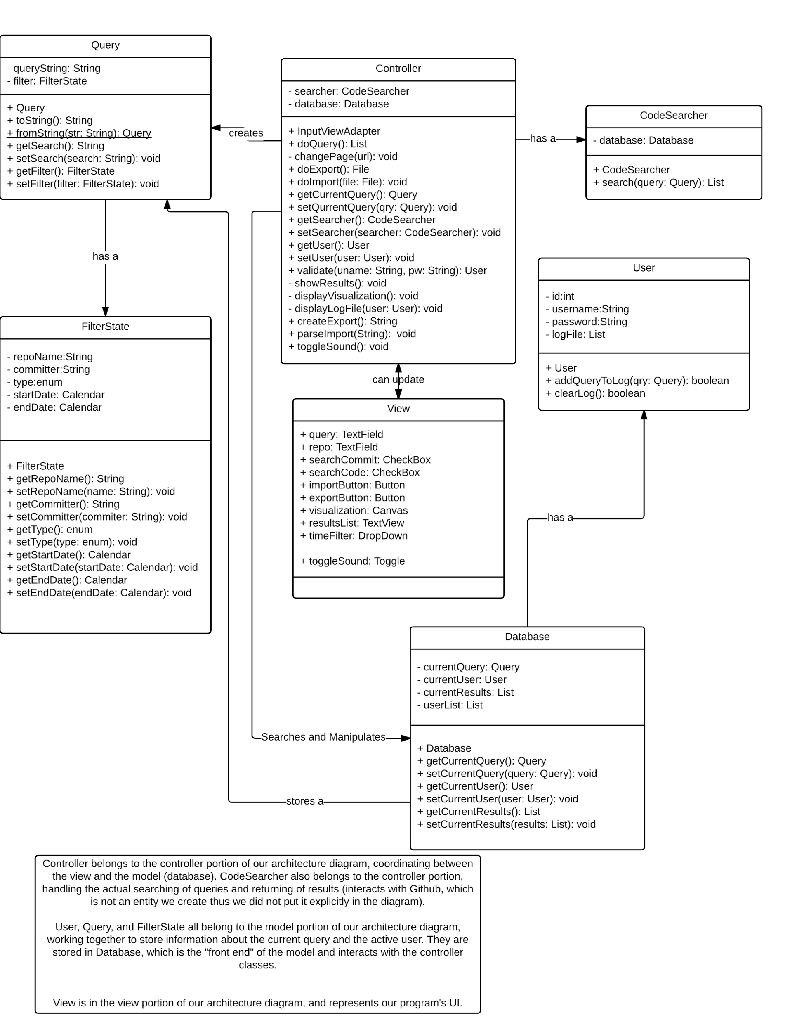
Class Diagram

Slide 15
Demonstration

